Slide 1

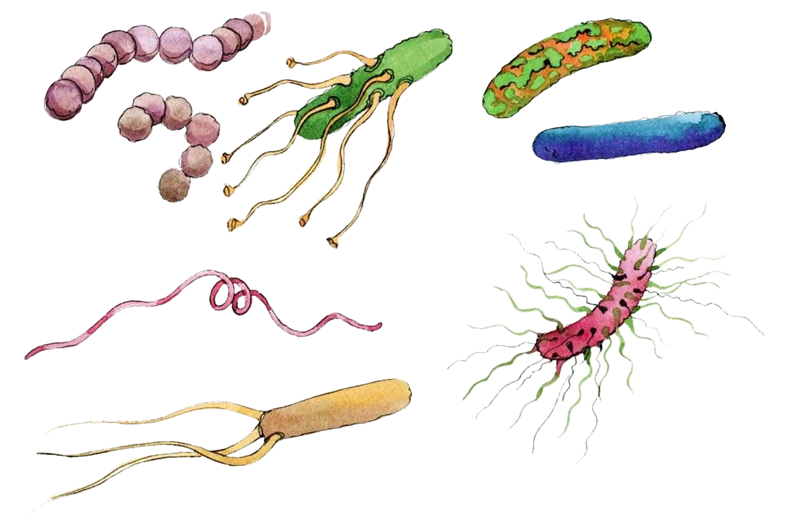




The influence of light on
soil microbial diversity structure and consequences for soil COS exchange
Supervisors : Lisa WINGATE, Nicolas FANIN
Clément FOUCAULT

Slide 2



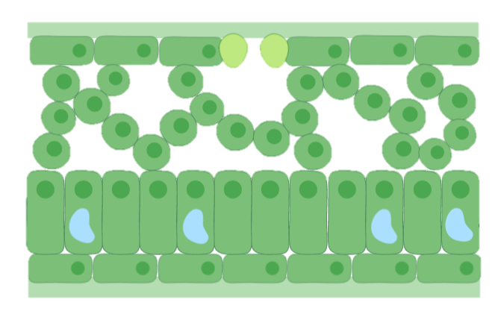

CONTEXT
EXPERIMENTAL DESIGN
RESULTS & DISCUSSION
CONCLUSION
Carbonyl sulfide (COS) is :
the most abundant sulfur compound naturally present in the atmosphere
naturally absorbed by terrestrial plants alongside with CO₂ by the enzyme carbonic anhydrase (CA).
Molecular structure of carbonyl sulfide
Source : Sandalls & Penkett, 1977
Source : Protoschill-Krebs et al., 1996
Stomata
Chloroplasts with CA
Cross-section of a leaf

Slide 3
CONTEXT
EXPERIMENTAL DESIGN
RESULTS & DISCUSSION
CONCLUSION
Carbonyl sulfide (COS) is :
the most abundant sulfur compound naturally present in the atmosphere
naturally absorbed by terrestrial plants alongside with CO₂ by the enzyme carbonic anhydrase (CA).
Molecular structure of carbonyl sulfide
Source : Sandalls & Penkett, 1977
Source : Protoschill-Krebs et al., 1996
Stomata
This makes COS a great proxy to estimate gross primary production.
Chloroplasts with CA
Cross-section of a leaf
Source : Campbell et al., 2008

Slide 4



CONTEXT
EXPERIMENTAL DESIGN
RESULTS & DISCUSSION
CONCLUSION
Soils are significant COS contributors !
COS
COS
COS hydrolysis by CA in soil microorganisms
Biotic and abiotic COS production in soils
Source : Kesselmeier et.al, 1999
Source : Whelan et.al, 2018

Slide 5



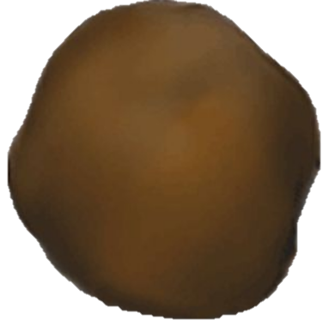
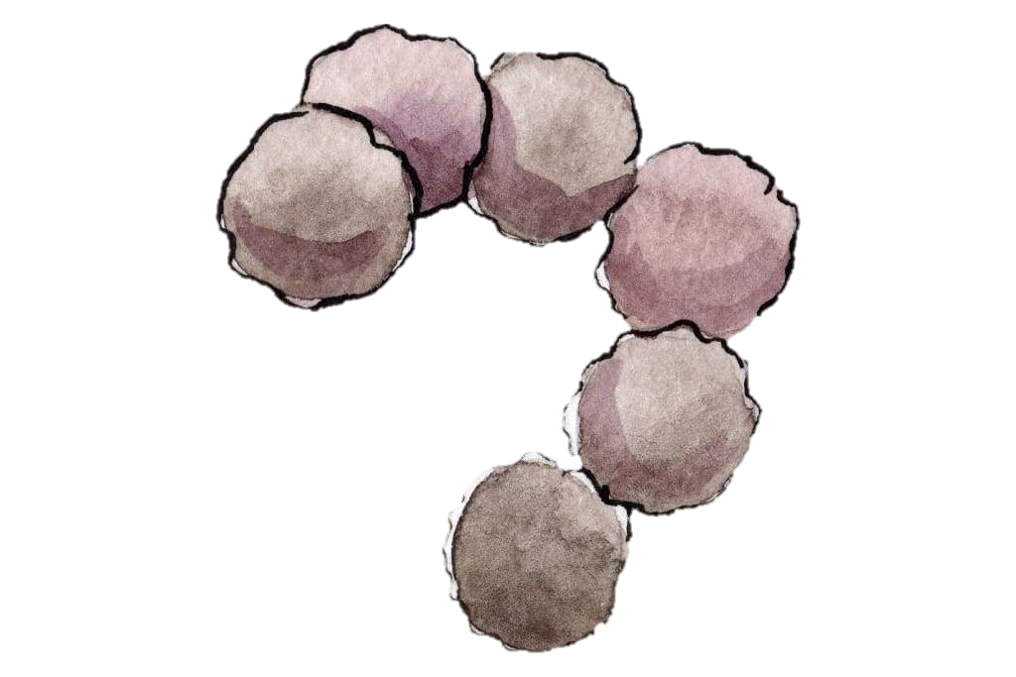
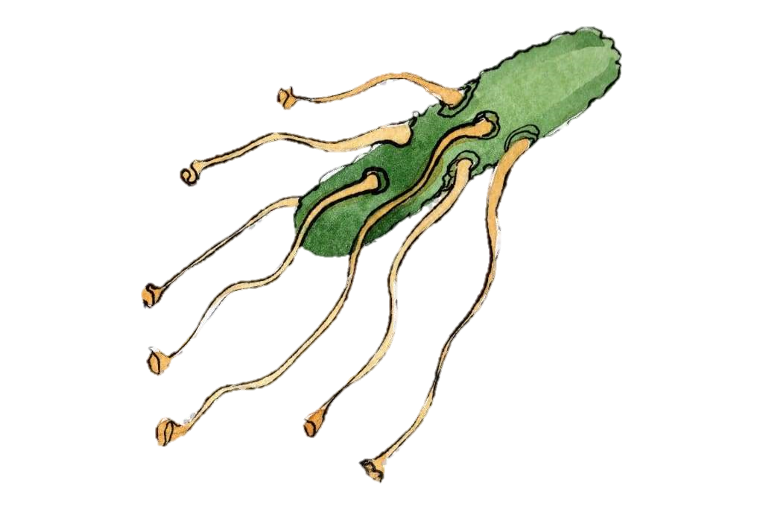



CONTEXT
EXPERIMENTAL DESIGN
RESULTS & DISCUSSION
CONCLUSION
COS fluxes in soils depend on several factors !
[COS] atm
Temperature
Source : Kesselmeier et.al, 1999
Source : Kesselmeier et.al, 1999
Soil moisture
Light
Source : Kesselmeier et.al, 1999
Source : Sauze et.al, 2017

Slide 6

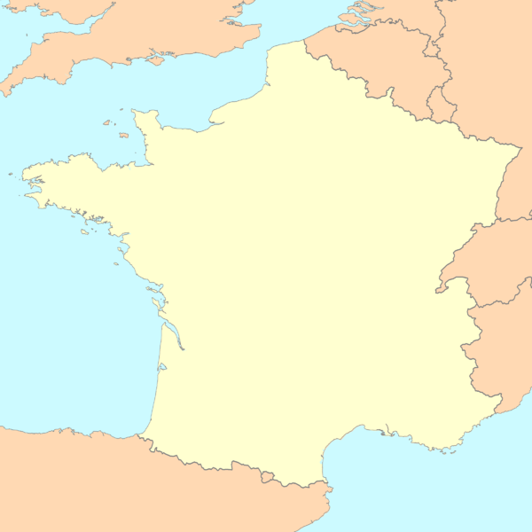



CONTEXT
EXPERIMENTAL DESIGN
RESULTS & DISCUSSION
CONCLUSION
Soil sampling
For each soil :
x 6
Location of the 4 sampling sites
DBZ
LG
TL
LB

Slide 7


CONTEXT
EXPERIMENTAL DESIGN
RESULTS & DISCUSSION
CONCLUSION
Soil sampling
For each soil :
x 6
Location of the 4 sampling sites
DBZ
16/24h in the light
8/24h in the dark
LG
TL
LB

Slide 8

CONTEXT
EXPERIMENTAL DESIGN
RESULTS & DISCUSSION
CONCLUSION
Soil sampling
For each soil :
x 6
Location of the 4 sampling sites
DBZ
16/24h in the light
2 different incubation treatments
8/24h in the dark
24/24h in the dark
LG
TL
LB

Slide 9

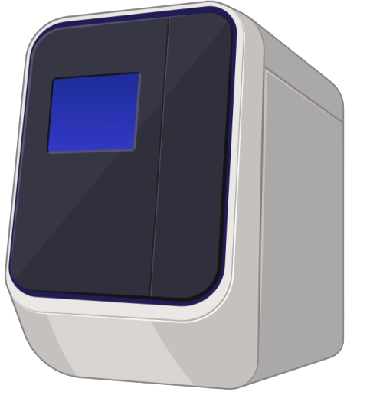


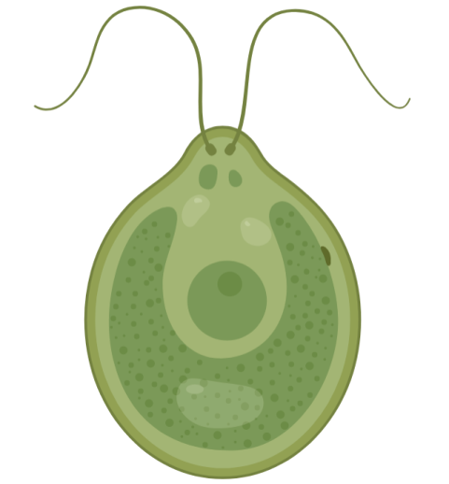
CONTEXT
EXPERIMENTAL DESIGN
RESULTS & DISCUSSION
CONCLUSION
Community analysis
1g of soil sampled out of each jar
1
Quantitative PCR
rRNA sequence
Group studied
16S
bacteria
18S
fungi
23S
phototrophs
Number of gene copies per microbial OTU, genus, family, …

Slide 10

CONTEXT
EXPERIMENTAL DESIGN
RESULTS & DISCUSSION
CONCLUSION
Community analysis
1g of soil sampled out of each jar
1
Quantitative PCR
rRNA sequence
Group studied
16S
bacteria
2
DNA metabarcoding
18S
fungi
23S
phototrophs
Number of gene copies per microbial OTU, genus, family, …
Identification of microbial communities OTUs

Slide 11
CONTEXT
EXPERIMENTAL DESIGN
RESULTS & DISCUSSION
CONCLUSION
What are we expecting ?
Phototrophs relying on light
(H1) The composition of phototroph communities will differ in light conditions compared with dark conditions.
Shade-tolerant cyanobacteria

Slide 12
CONTEXT
EXPERIMENTAL DESIGN
RESULTS & DISCUSSION
CONCLUSION
What are we expecting ?
Phototrophs relying on light
(H1) The composition of phototroph communities will differ in light conditions compared with dark conditions.
Shade-tolerant cyanobacteria
(H2) Shifts in the composition of phototroph communities will affect heterotrophic microbial communities.
Algal parasites/predators
Bacterial and fungal copiotrophs

Slide 13
CONTEXT
EXPERIMENTAL DESIGN
RESULTS & DISCUSSION
CONCLUSION
What are we expecting ?
Phototrophs relying on light
(H1) The composition of phototroph communities will differ in light conditions compared with dark conditions.
Shade-tolerant cyanobacteria
(H2) Shifts in the composition of phototroph communities will affect heterotrophic microbial communities.
Algal parasites/predators
Bacterial and fungal copiotrophs
(H3) Shifts in the composition of microbial communities altogether will have repercussions on COS fluxes.
Linked with COS emission : Mortierellomycetes
Source : Kitz et al., 2019, Masaki et al., 2016
Linked with COS consumption : Phototrophs !
And other bacteria and fungi : Actinobacteria, Sordariomycetes and Leotiomycetes.
Source : Ogawa et al., 2016, Masaki et al., 2016, Meredith et al., 2019

Slide 14

CONTEXT
EXPERIMENTAL DESIGN
RESULTS & DISCUSSION
CONCLUSION
Statistical analyses
at the class taxonomic level !
1. Permanovas
2. Mixed effect linear model
Test performed
Underlying question
Do soil types and light treatments significantly influence microbial community composition ?
Do soil types and light treatments significantly influence CO₂ and COS balance in soils ?
gas flux ~ light treatment * soil type
with random = position of the jar in the chamber
Factors
abundance ~ light treatment * soil type
x 3 : for phototrophs, bacteria and fungi
x 2 : for CO₂ and COS
Details

Slide 15
CONTEXT
EXPERIMENTAL DESIGN
RESULTS & DISCUSSION
CONCLUSION
Statistical analyses
at the class taxonomic level !
3. Canonical correspondence analysis
4. Generalized linear latent variable model
Test performed
Underlying question
What is the variation between the different soil communities and how much of the variability is explained by environmental variables ?
How can microbial community composition explain COS fluxes ?
abundance ~ land use + sand content + pH + silt content + C:N ratio + light treatment + COS flux + CO₂ flux
abundance ~ COS flux
For each light treatment
Factors
x 3 : for phototrophs, bacteria and fungi
x 6 : for each organisms group (x3) under either light or dark (x2)
Details

Slide 16
CONTEXT
EXPERIMENTAL DESIGN
RESULTS & DISCUSSION
CONCLUSION
Statistical analyses
at the class taxonomic level !
Test performed
5. Network analysis
Underlying question
How do the abundances of the different microbial classes correlate with each other?
Factors
We only used the microbial classes correlated with COS fluxes in the test n°4
x 2 : for light and for dark
Details

Slide 17
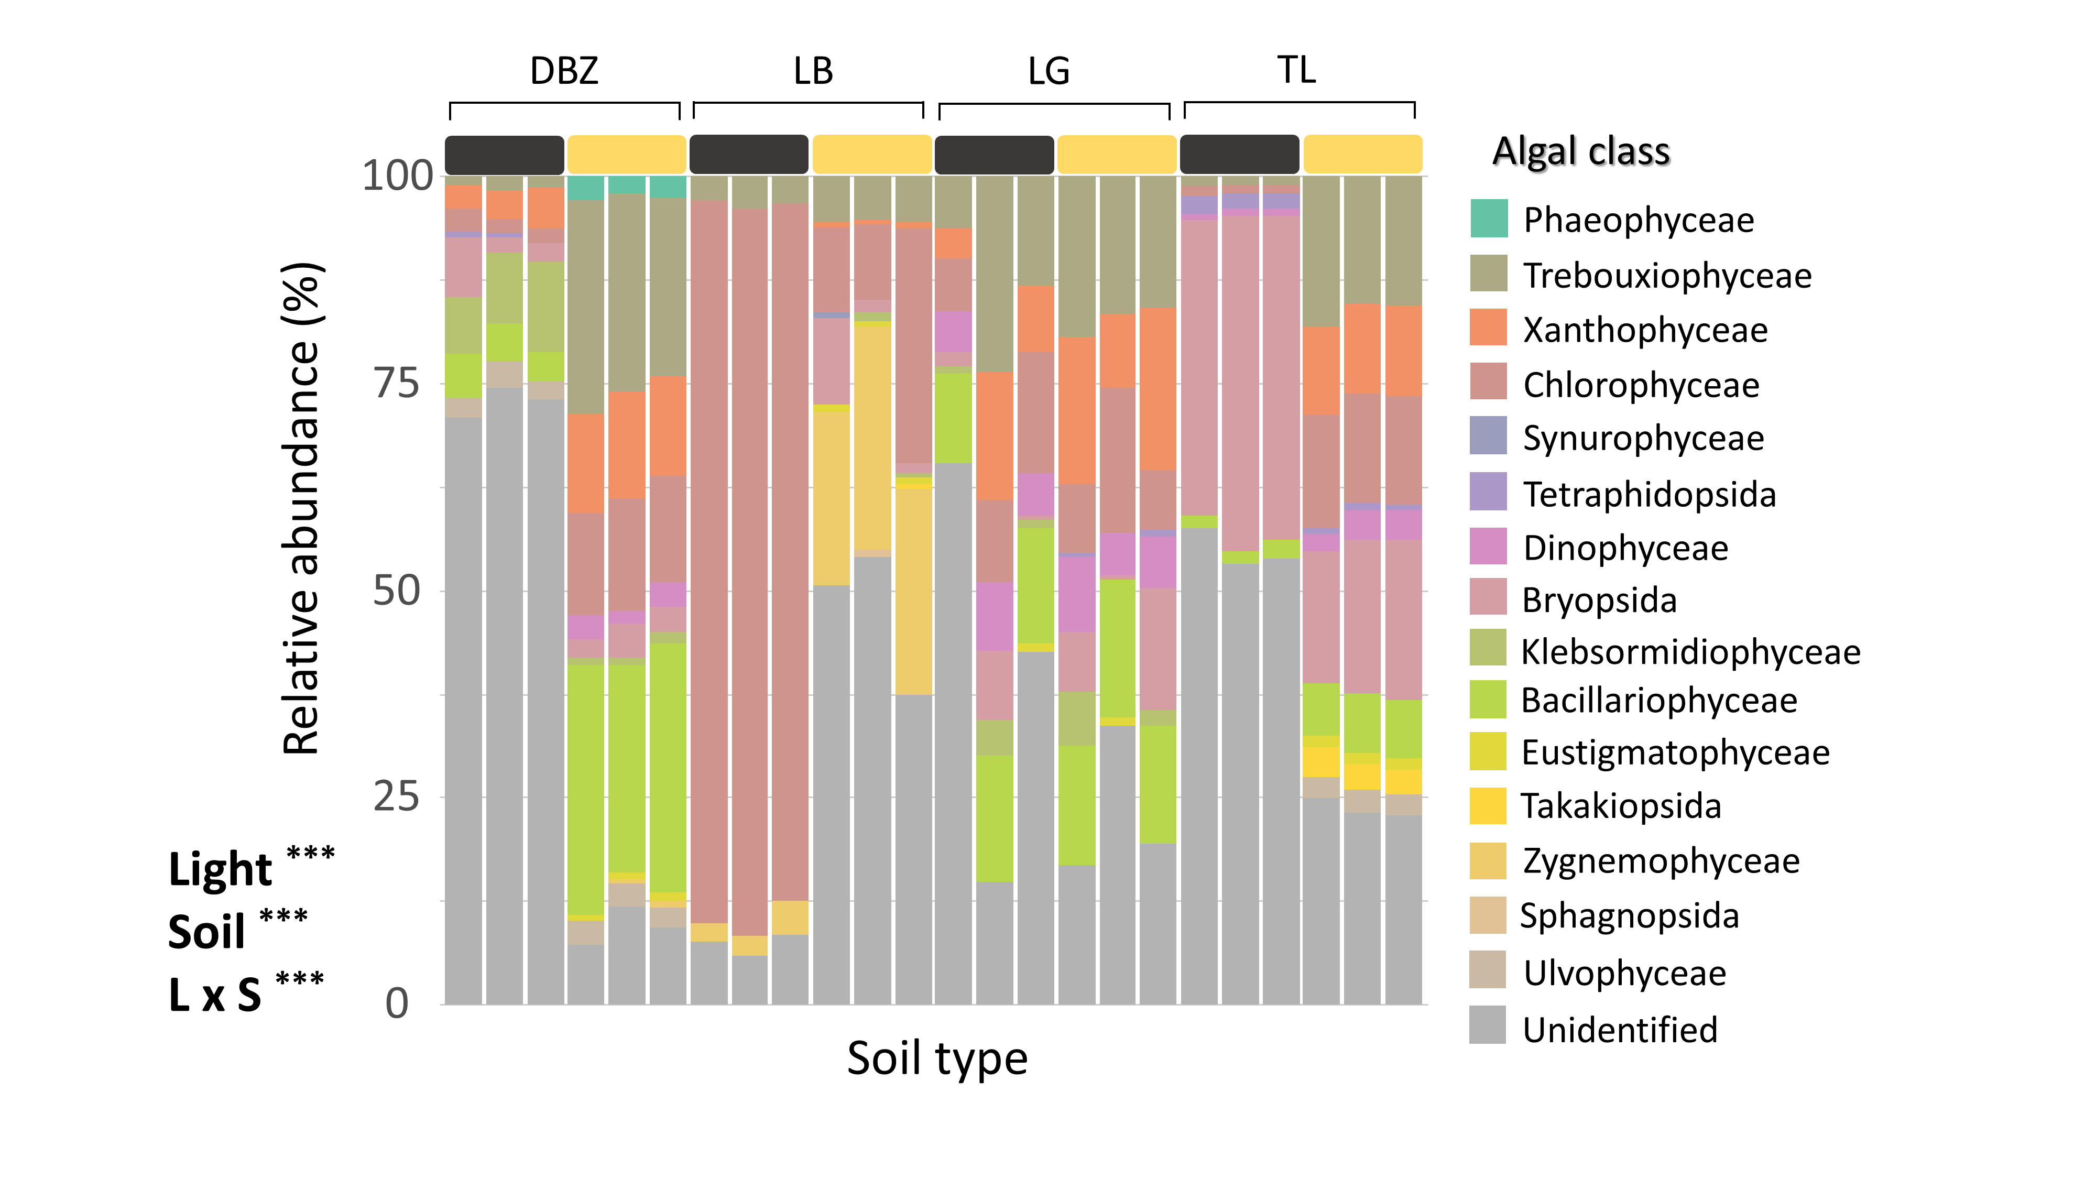
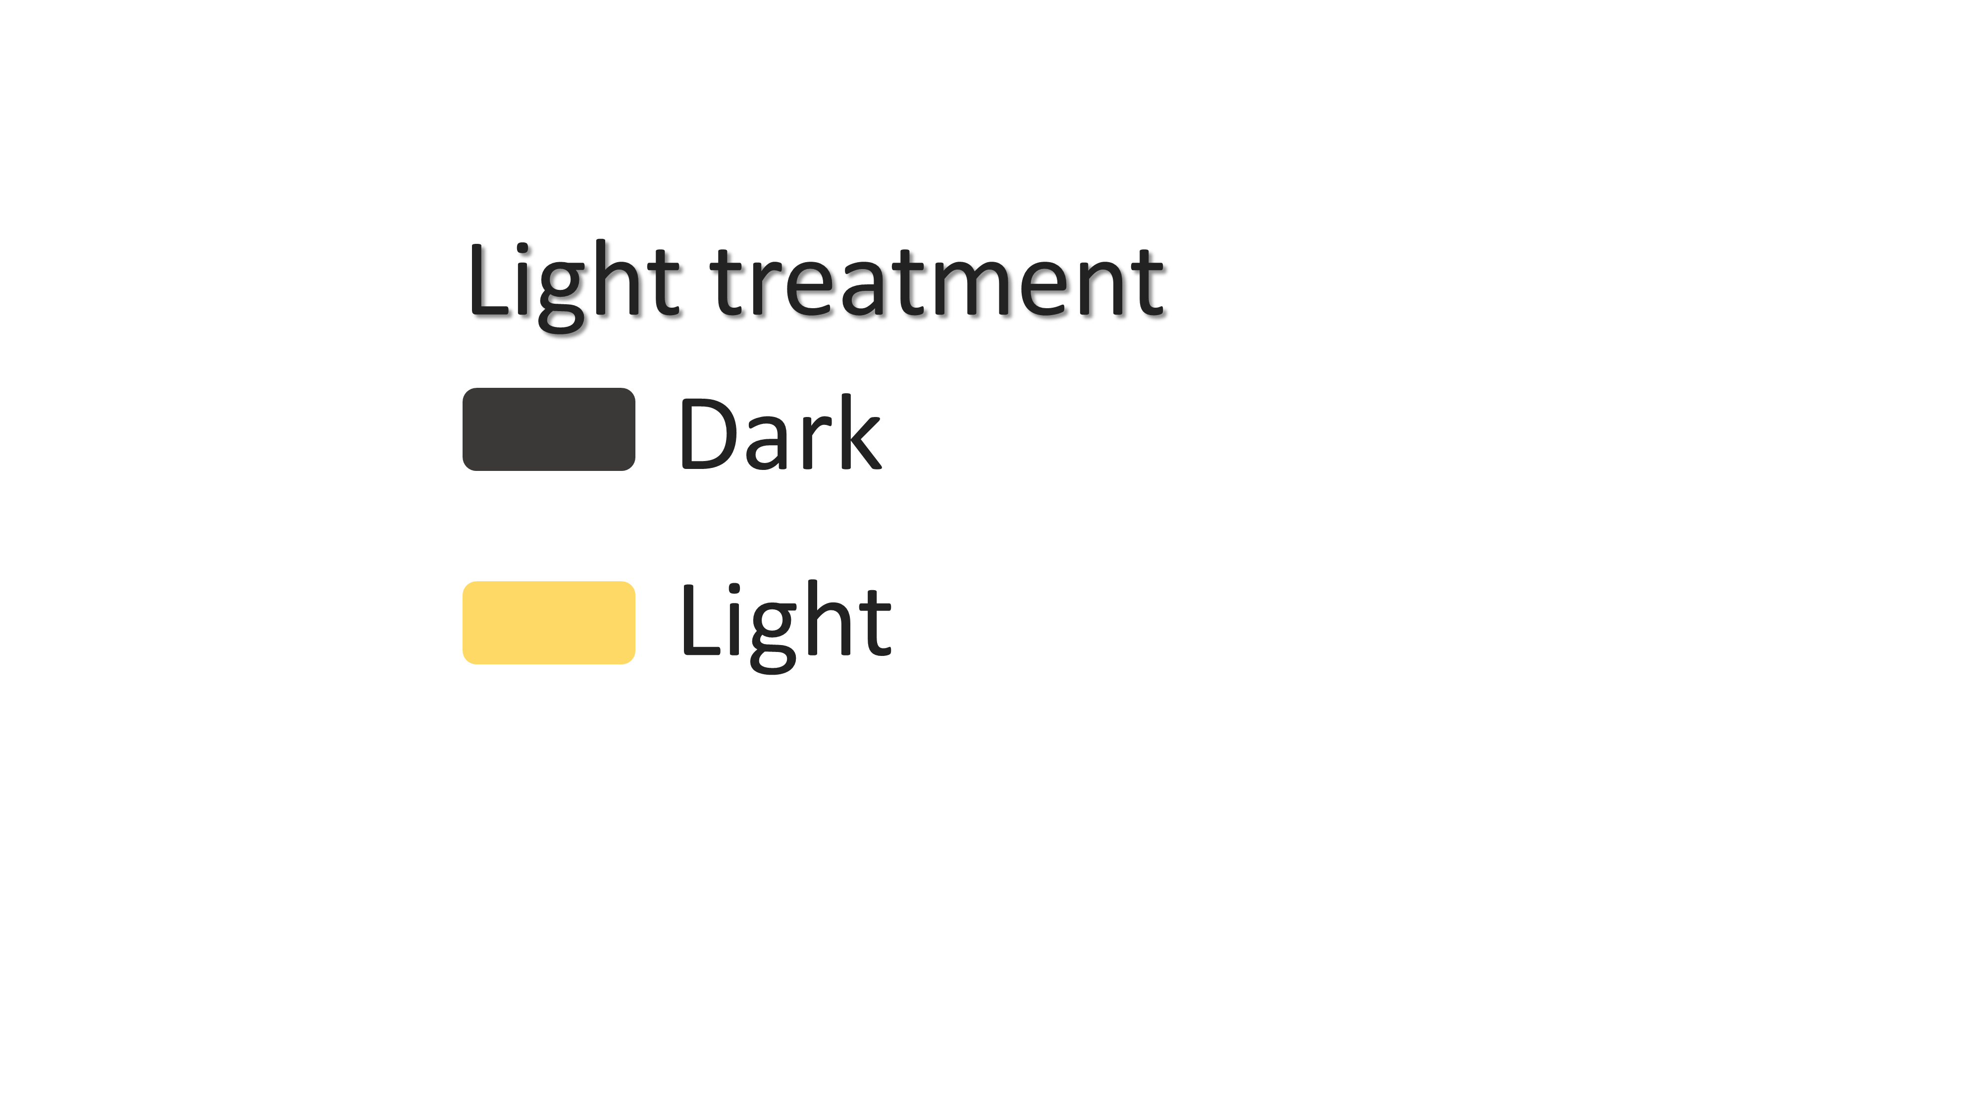
CONTEXT
EXPERIMENTAL DESIGN
RESULTS & DISCUSSION
CONCLUSION
Results
Investigating the first hypothesis
Community composition for phototrophs across the different soil types and light treatments.

Slide 18
CONTEXT
EXPERIMENTAL DESIGN
RESULTS & DISCUSSION
CONCLUSION
Results
Investigating the first hypothesis
Community composition for phototrophs across the different soil types and light treatments.

Slide 19
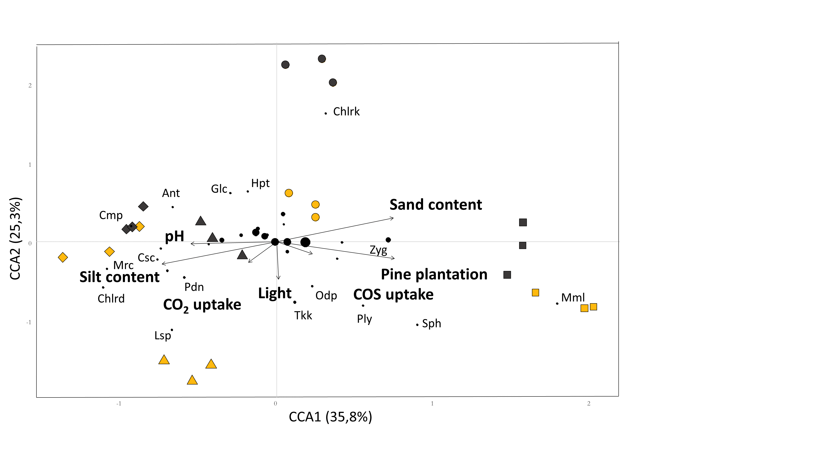
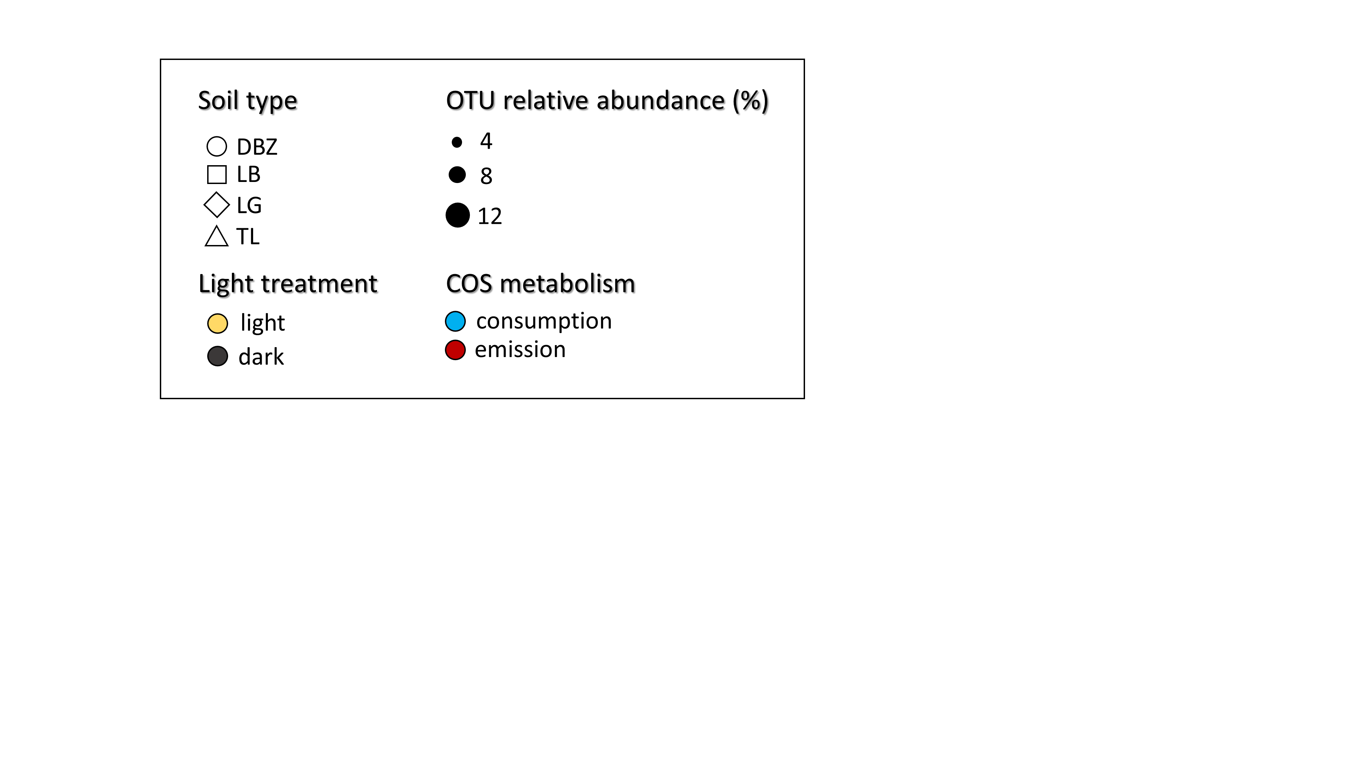
CONTEXT
EXPERIMENTAL DESIGN
RESULTS & DISCUSSION
CONCLUSION
Results
Phototrophs CCA
Canonical-correspondence analysis for phototroph communities. Relative abundance is based on the four soils together.

Slide 20
CONTEXT
EXPERIMENTAL DESIGN
RESULTS & DISCUSSION
CONCLUSION
Results
Phototrophs CCA
Canonical-correspondence analysis for phototroph communities. Relative abundance is based on the four soils together.

Slide 21

CONTEXT
EXPERIMENTAL DESIGN
RESULTS & DISCUSSION
CONCLUSION
Results
Phototrophs CCA
Canonical-correspondence analysis for phototroph communities. Relative abundance is based on the four soils together.

Slide 22
CONTEXT
EXPERIMENTAL DESIGN
RESULTS & DISCUSSION
CONCLUSION
Results
Phototrophs CCA
Canonical-correspondence analysis for phototroph communities. Relative abundance is based on the four soils together.

Slide 23
CONTEXT
EXPERIMENTAL DESIGN
RESULTS & DISCUSSION
CONCLUSION
Results
Phototrophs CCA
Canonical-correspondence analysis for phototroph communities. Relative abundance is based on the four soils together.

Slide 24
CONTEXT
EXPERIMENTAL DESIGN
RESULTS & DISCUSSION
CONCLUSION
Results
Phototrophs CCA
Non-significant between light and dark
Canonical-correspondence analysis for phototroph communities. Relative abundance is based on the four soils together.

Slide 25
CONTEXT
EXPERIMENTAL DESIGN
RESULTS & DISCUSSION
CONCLUSION
Results
Phototrophs CCA
Canonical-correspondence analysis for phototroph communities. Relative abundance is based on the four soils together.

Slide 26
CONTEXT
EXPERIMENTAL DESIGN
RESULTS & DISCUSSION
CONCLUSION
Results
Phototrophs CCA
Canonical-correspondence analysis for phototroph communities. Relative abundance is based on the four soils together.

Slide 27
CONTEXT
EXPERIMENTAL DESIGN
RESULTS & DISCUSSION
CONCLUSION
Results
Phototrophs CCA
Canonical-correspondence analysis for phototroph communities. Relative abundance is based on the four soils together.

Slide 28
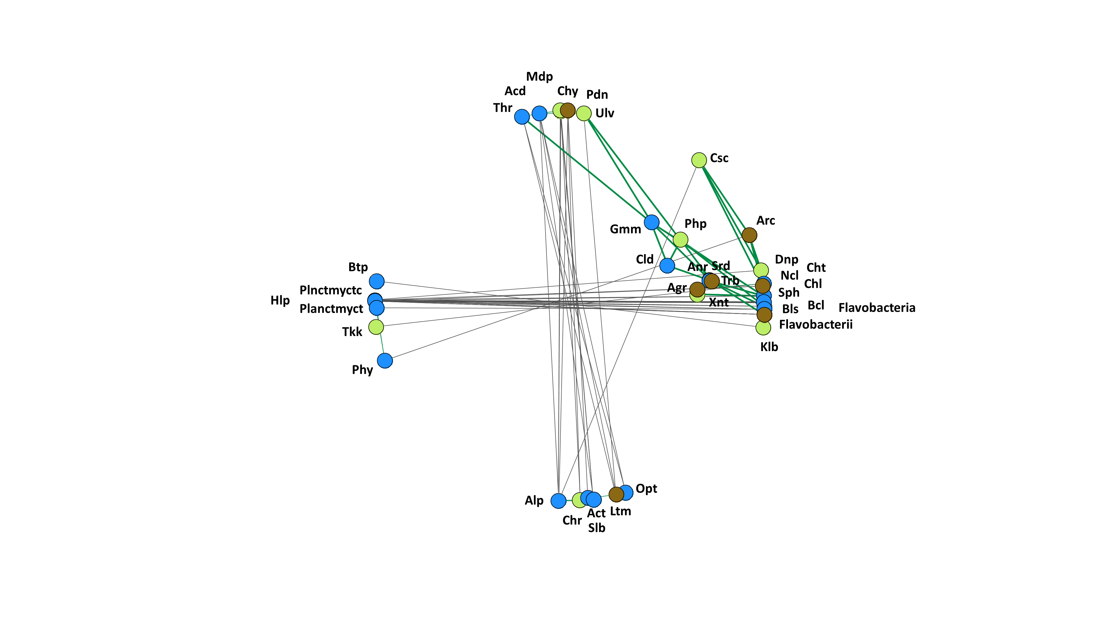

CONTEXT
EXPERIMENTAL DESIGN
RESULTS & DISCUSSION
CONCLUSION
Results
Investigating the 2nd hypothesis
Parasites / predators of phototrophs ?
Copiotrophic organisms ?
Network analysis focused on phototroph, bacterial and fungal classes that showed associations with COS uptake or emission.

Slide 29

CONTEXT
EXPERIMENTAL DESIGN
RESULTS & DISCUSSION
CONCLUSION
Results
Parasites / predators of phototrophs !
B
Chytridiomycetes
A
C
A
C
Mediophyceae
B
Ulvophyceae
Pedinophyceae
Copiotrophic organisms ?
Network analysis focused on phototroph, bacterial and fungal classes that showed associations with COS uptake or emission.

Slide 30
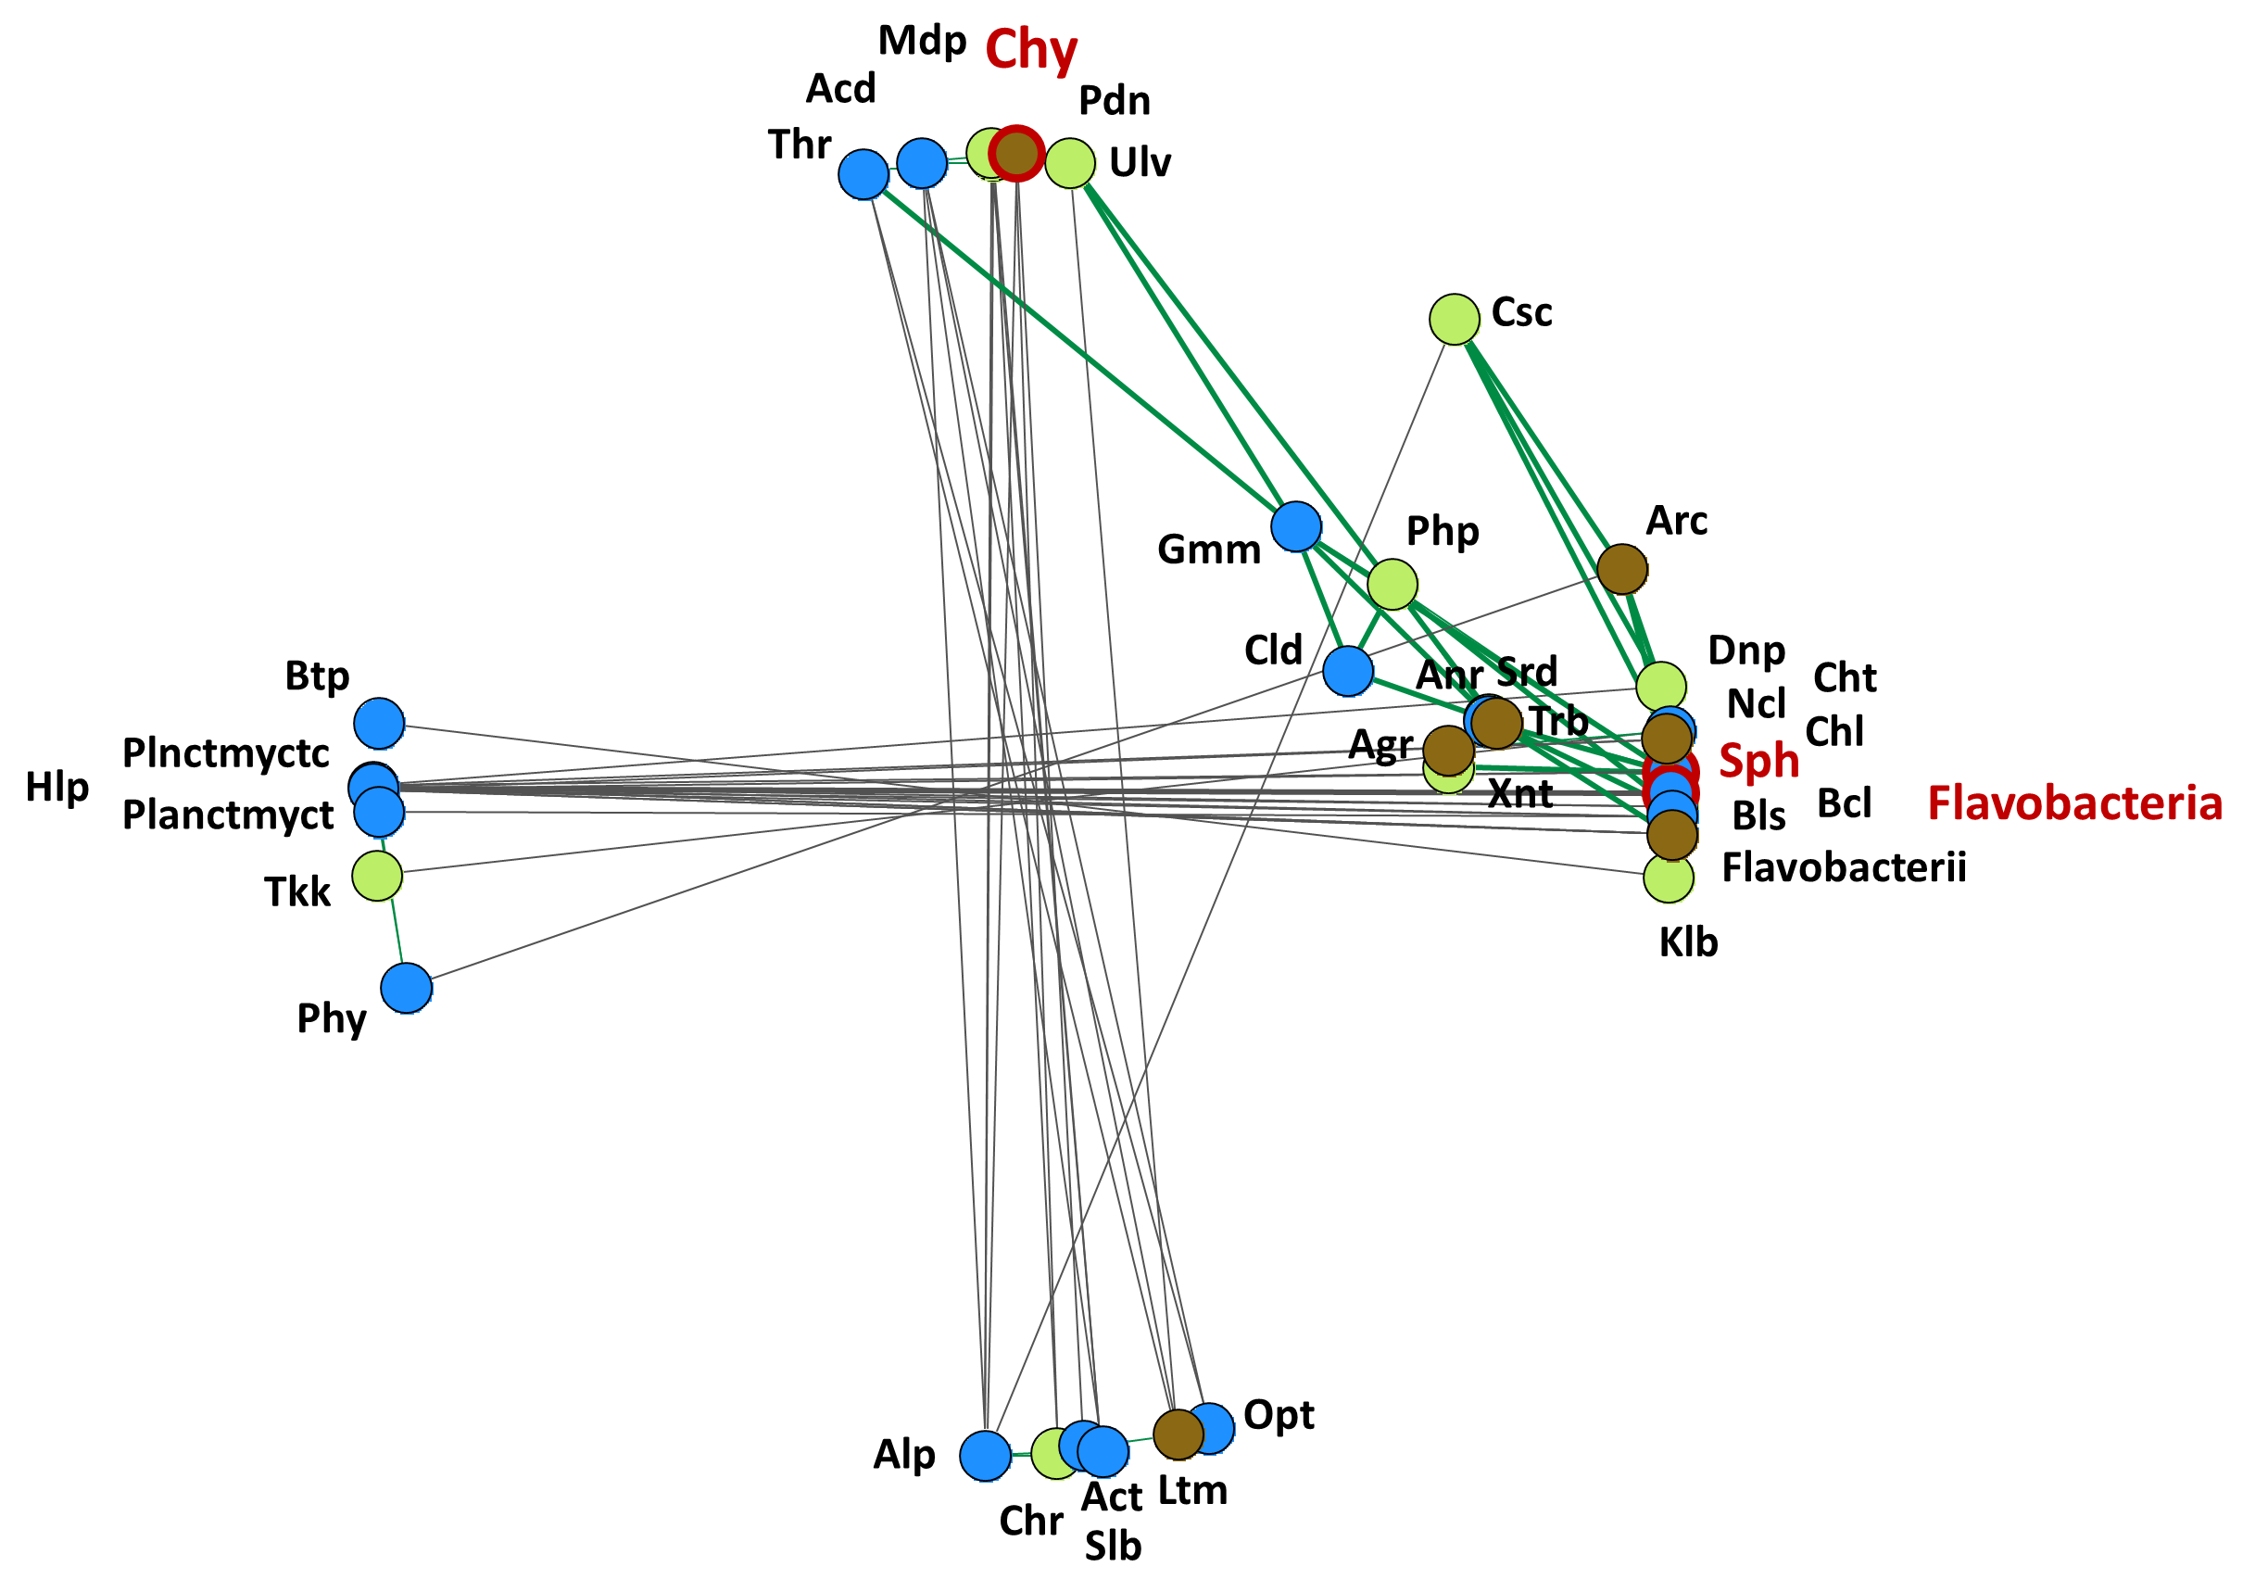
CONTEXT
EXPERIMENTAL DESIGN
RESULTS & DISCUSSION
CONCLUSION
Results
Parasites / predators of phototrophs !
Chytridiomycetes
A
C
Mediophyceae
B
Ulvophyceae
1
Pedinophyceae
2
Copiotrophic organisms !
4
1
3
2
3
Flavobacteria
Sphingobacteria
4
1. Dinophyceae
3. Klebsormidiophyceae
2. Bacillariophyceae
4. Xanthophyceae

Slide 31
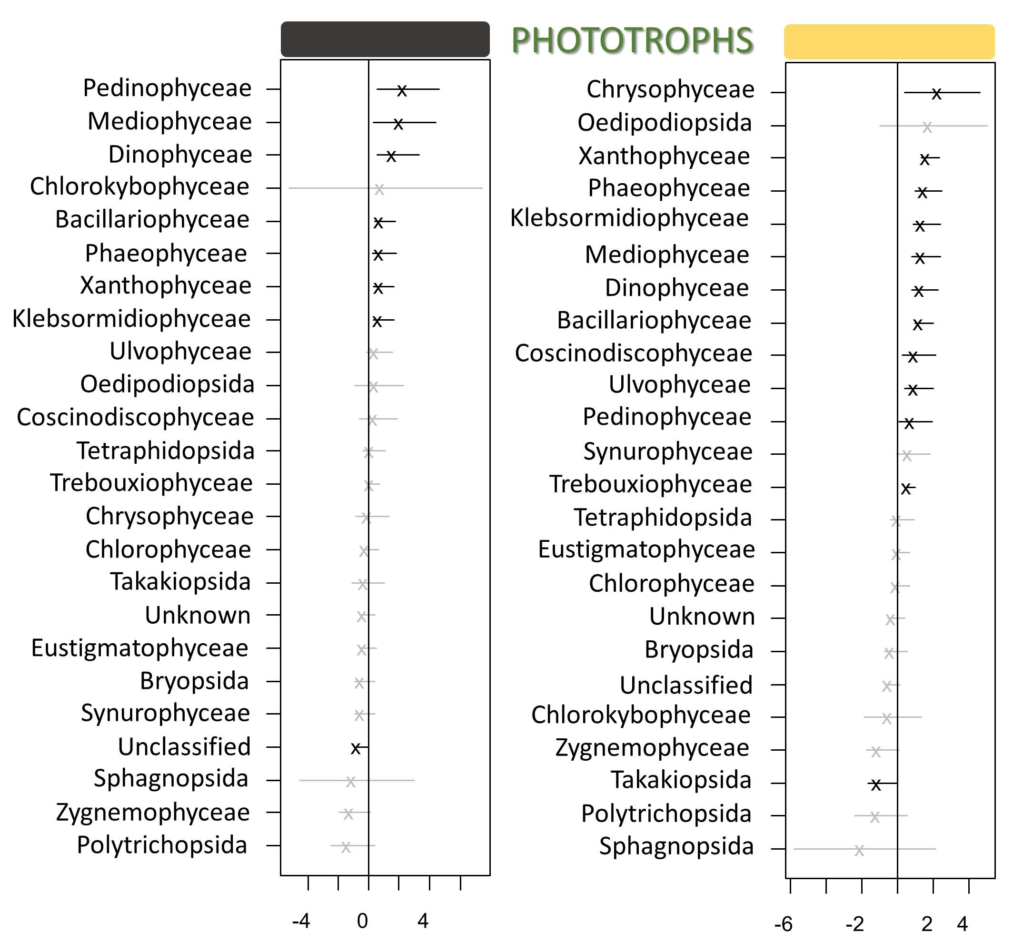
CONTEXT
EXPERIMENTAL DESIGN
RESULTS & DISCUSSION
CONCLUSION
Results
Investigating the 3rd hypothesis
Generalized latent linear variable model focused on the impact of phototroph classes on COS emission or uptake.

Slide 32
CONTEXT
EXPERIMENTAL DESIGN
RESULTS & DISCUSSION
CONCLUSION
Results
Investigating the 3rd hypothesis
Generalized latent linear variable model focused on the impact of phototroph classes on COS emission or uptake.

Slide 33
CONTEXT
EXPERIMENTAL DESIGN
RESULTS & DISCUSSION
CONCLUSION
Results
Investigating the 3rd hypothesis
Generalized latent linear variable model focused on the impact of phototroph classes on COS emission or uptake.

Slide 34
CONTEXT
EXPERIMENTAL DESIGN
RESULTS & DISCUSSION
CONCLUSION
Results
Investigating the 3rd hypothesis
Generalized latent linear variable model focused on the impact of phototroph classes on COS emission or uptake.

Slide 35
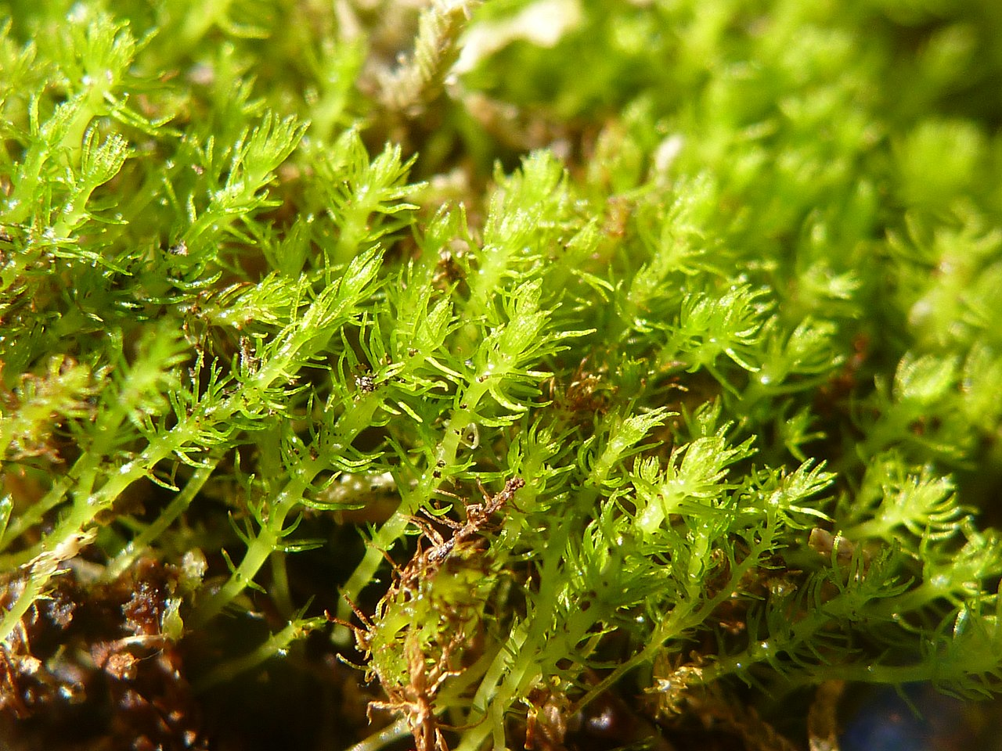
CONTEXT
EXPERIMENTAL DESIGN
RESULTS & DISCUSSION
CONCLUSION
Results
Investigating the 3rd hypothesis
Takakia lepidozioides growing on damp slope above Takakia Lake, Haida Gwaii.
Picture from Stu Crawford.
Generalized latent linear variable model focused on the impact of phototroph classes on COS emission or uptake.

Slide 36
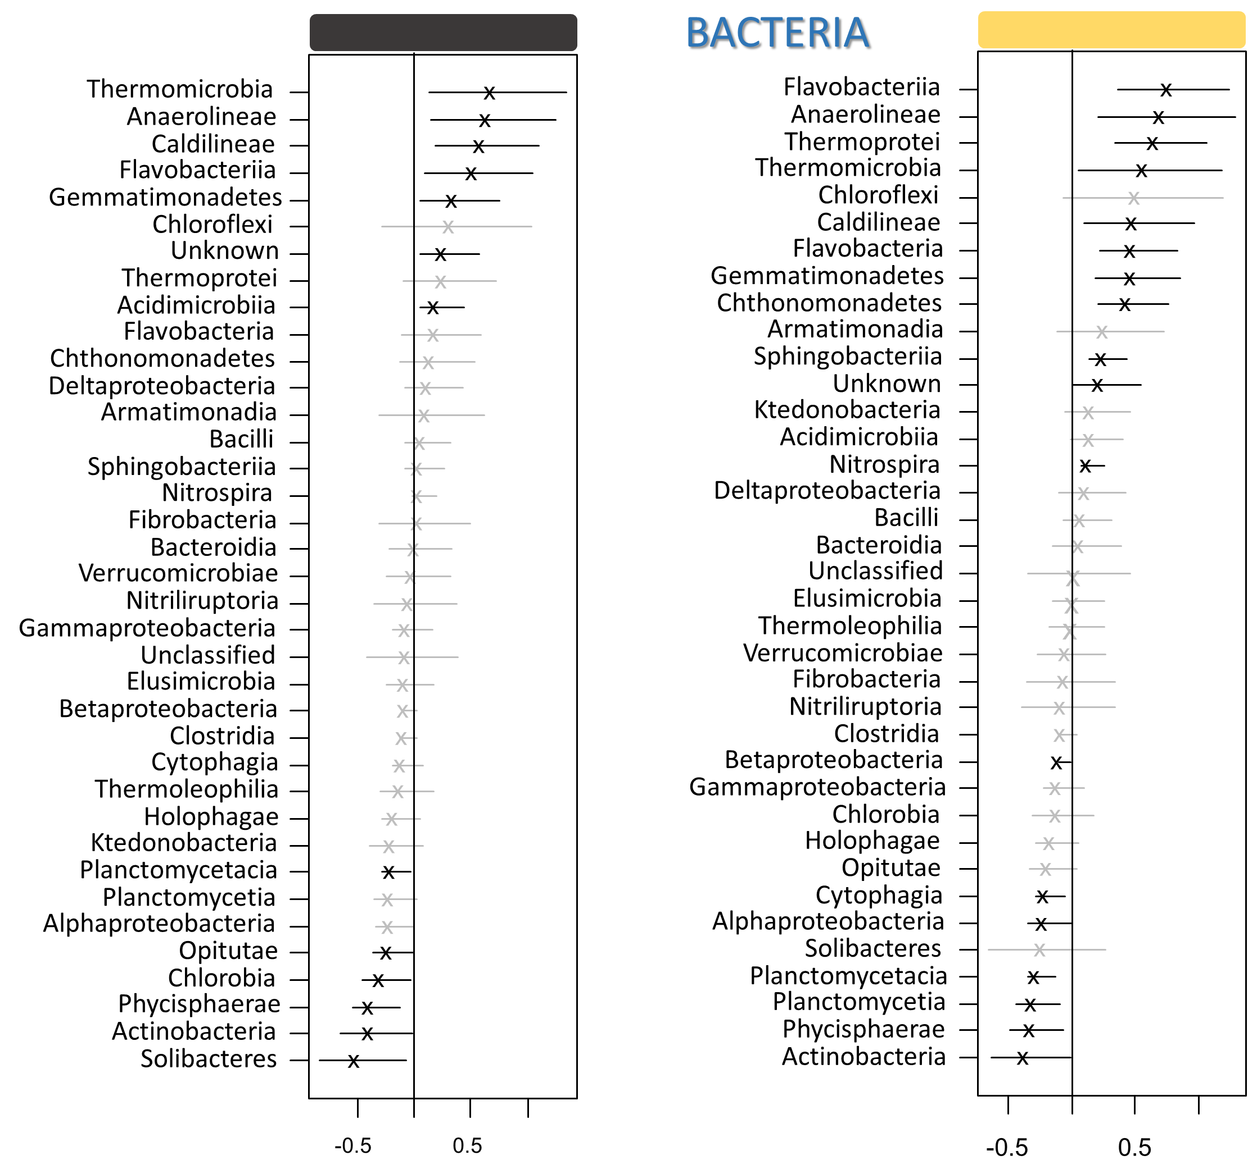
CONTEXT
EXPERIMENTAL DESIGN
RESULTS & DISCUSSION
CONCLUSION
Results
Investigating the 3rd hypothesis
Generalized latent linear variable model focused on the impact of bacterial classes on COS emission or uptake.

Slide 37
CONTEXT
EXPERIMENTAL DESIGN
RESULTS & DISCUSSION
CONCLUSION
Results
Investigating the 3rd hypothesis
Already identified as COS consumers :
Phycisphaerae in Meredith et al. (2018)
Actinobacteria in Ogawa et al. (2016), Meredith et al. (2018)
Generalized latent linear variable model focused on the impact of bacterial classes on COS emission or uptake.

Slide 38
CONTEXT
EXPERIMENTAL DESIGN
RESULTS & DISCUSSION
CONCLUSION
Results
Investigating the 3rd hypothesis
Already identified as COS consumers :
Phycisphaerae in Meredith et al. (2018)
Actinobacteria in Ogawa et al. (2016), Meredith et al. (2018)
Interactions :
Phycisphaerae
One + interaction with phototrophs
Takakiopsida
Actinobacteria
One + interaction with phototrophs
Chrysophyceae
Generalized latent linear variable model focused on the impact of bacterial classes on COS emission or uptake.

Slide 39

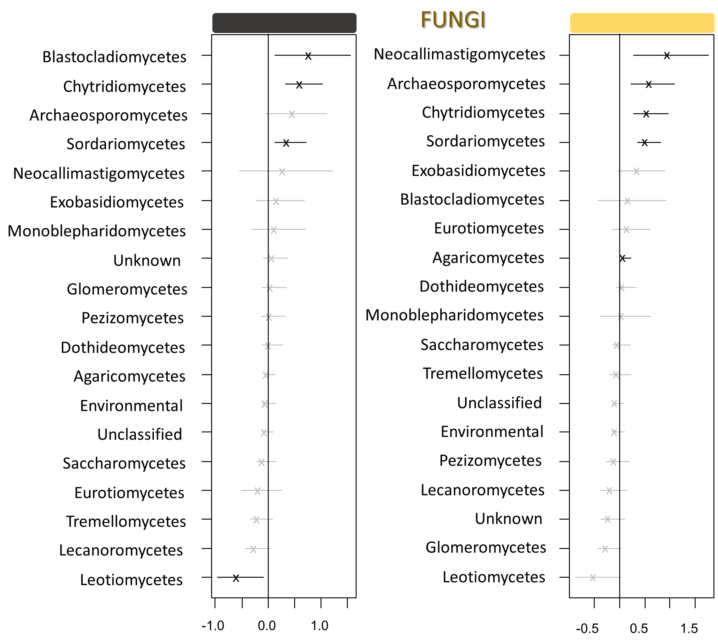
CONTEXT
EXPERIMENTAL DESIGN
RESULTS & DISCUSSION
CONCLUSION
Results
Investigating the 3rd hypothesis
Generalized latent linear variable model focused on the impact of fungal classes on COS emission or uptake.

Slide 40
CONTEXT
EXPERIMENTAL DESIGN
RESULTS & DISCUSSION
CONCLUSION
Results
Investigating the 3rd hypothesis
Mortierellomycetes is not a COS producer in our study.
Generalized latent linear variable model focused on the impact of fungal classes on COS emission or uptake.

Slide 41
CONTEXT
EXPERIMENTAL DESIGN
RESULTS & DISCUSSION
CONCLUSION
Results
Investigating the 3rd hypothesis
Mortierellomycetes is not a COS producer in our study.
Already identified as COS consumers :
Sordariomycetes in Meredith et al. (2018), Whelan et al. (2018)
Leotiomycetes in Meredith et al. (2018), Whelan et al. (2018)
However ! Sordariomycetes appears as a producer in our study …
Generalized latent linear variable model focused on the impact of fungal classes on COS emission or uptake.

Slide 42
CONTEXT
EXPERIMENTAL DESIGN
RESULTS & DISCUSSION
CONCLUSION
Results
Investigating the 3rd hypothesis
Mortierellomycetes is not a COS producer in our study.
Already identified as COS consumers :
Sordariomycetes in Meredith et al. (2018), Whelan et al. (2018)
Leotiomycetes in Meredith et al. (2018), Whelan et al. (2018)
However ! Sordariomycetes appears as a producer in our study …
Generalized latent linear variable model focused on the impact of fungal classes on COS emission or uptake.

Slide 43
CONTEXT
EXPERIMENTAL DESIGN
RESULTS & DISCUSSION
CONCLUSION
Results
Investigating the 3rd hypothesis
Mortierellomycetes is not a COS producer in our study.
Already identified as COS consumers :
Sordariomycetes in Meredith et al. (2018), Whelan et al. (2018)
Leotiomycetes in Meredith et al. (2018), Whelan et al. (2018)
However ! Sordariomycetes appears as a producer in our study …
Interactions :
Leotiomycetes
One + interaction with phototrophs
Chrysophyceae
Generalized latent linear variable model focused on the impact of fungal classes on COS emission or uptake.

Slide 44

CONTEXT
EXPERIMENTAL DESIGN
RESULTS & DISCUSSION
CONCLUSION
Conclusions
(H1) The composition of phototroph communities will differ in light conditions compared with dark conditions.
Phototroph communities dominated by mixotrophic cyanobacteria.
Significant increase of obligatory photosynthetic classes at the expense of cyanobacteria.

Slide 45
CONTEXT
EXPERIMENTAL DESIGN
RESULTS & DISCUSSION
CONCLUSION
Conclusions
(H1) The composition of phototroph communities will differ in light conditions compared with dark conditions.
Phototroph communities dominated by mixotrophic cyanobacteria.
Significant increase of obligatory photosynthetic classes at the expense of cyanobacteria.
(H2) Shifts in the composition of phototroph communities will affect heterotrophic microbial communities.
In the light, many positive associations between the abundance of algae and that of algae parasites / predators / fast growing microbial classes.

Slide 46

CONTEXT
EXPERIMENTAL DESIGN
RESULTS & DISCUSSION
CONCLUSION
Conclusions
(H1) The composition of phototroph communities will differ in light conditions compared with dark conditions.
Phototroph communities dominated by mixotrophic cyanobacteria.
Significant increase of obligatory photosynthetic classes at the expense of cyanobacteria.
(H2) Shifts in the composition of phototroph communities will affect heterotrophic microbial communities.
In the light, many positive associations between the abundance of phototrophs and that of algae parasites / predators / fast growing microbial classes.
(H3) Shifts in the composition of microbial communities altogether will have repercussions on COS fluxes.
Many bacteria and fungi identified in accordance with current knowledge in the literature.
Several inconsistencies, probably due to the use of the class taxonomic level.
Main microbial actors within COS fluxes were linked both in light and dark conditions.

Slide 47

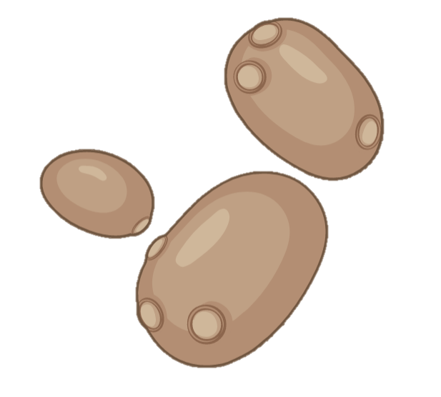

In research on COS fluxes, usual focus on vascular plants
HOWEVER …
Many important members of soil communities impact COS fluxes
Phycosphere applied to soils
It proves itself relevant !
Fungal organisms
= both COS consumption and emission
Free-living phototroph
= COS consumption
Bacteria
= both COS consumption and emission
Region enriched in organic substrates exuded by the cell

Slide 48

In research on COS fluxes, the usual focus is on vascular plants
HOWEVER …
Many important members of soil communities impact COS fluxes
Phycosphere applied to soils
It proves itself relevant !
Fungal organisms
= both COS consumption and emission
Free-living phototroph
= COS consumption
Bacteria
= both COS consumption and emission
Region enriched in organic substrates exuded by the cell
Thank you

Slide 49

References :
Campbell, J.,Carmichael, G., Chai, T., Mena-Carrasco, M., Tang, Y., Blake, D., … Stanier, C. (2008). Photosynthetic Control of Atmospheric Carbonyl Sulfide During the Growing Season. Science (New York, N.Y.), 322, 1085–1088.
Kesselmeier, J., N. Teusch, et U. Kuhn. « Controlling Variables for the Uptake of Atmospheric Carbonyl Sulfide by Soil ». Journal of Geophysical Research: Atmospheres 104, nº D9 (1999): 11577‑84.
Kitz, F., Gómez-Brandón, M., Eder, B., Etemadi, M., Spielmann, F. M., Hammerle, A., …Wohlfahrt, G. (2019). Soil carbonyl sulfide exchange in relation to microbial community composition: Insights from a managed grassland soil amendment experiment. Soil Biology and Biochemistry, 135, 28–37.
Masaki, Y., Ozawa, R., Kageyama, K., & Katayama, Y. (2016). Degradation and emission of carbonyl sulfide, an atmospheric trace gas, by fungi isolated from forest soil. FEMS Microbiology Letters, 363(18).
Meredith, L. K., Ogée, J., Boye, K., Singer, E., Wingate, L., von Sperber, C., … Welander, P. V. (2019). Soil exchange rates of COS and CO 18 O differ with the diversity of microbial communities and their carbonic anhydrase enzymes. The ISME Journal, 13(2), 290–300.
Ogawa, T., Kato, H., Higashide, M., Nishimiya, M., & Katayama, Y. (2016). Degradation of carbonyl sulfide by Actinomycetes and detection of clade D of β-class carbonic anhydrase. FEMS Microbiology Letters, 363(19).
Protoschill-Krebs, G., Wilhelm, C., & Kesselmeier, J. (1996). Consumption of carbonyl sulphide (COS) byhigher plant carbonic anhydrase (CA). Atmospheric Environment, 30(18)
Sandalls, F. J., & Penkett, S. A. (1977). Measurements of carbonyl sulphide and carbon: Disulphide in the atmosphere. Atmospheric Environment (1967), 11(2), 197–199.
Sauze J., Ogée J., Maron P.A., Crouzet O., Nowak V., Wohl S., Kaisermann A., Jones S.P., Wingate L.. « The Interaction of Soil Phototrophs and Fungi with PH and Their Impact on Soil CO2, CO18O and OCS Exchange ». Soil Biology and Biochemistry 115 (1 décembre 2017): 371‑82.
Whelan, Mary E., Sinikka T. Lennartz, Teresa E. Gimeno, Richard Wehr, Georg Wohlfahrt, Yuting Wang, Linda M. J. Kooijmans, et al. « Reviews and Syntheses: Carbonyl Sulfide as a Multi-Scale Tracer for Carbon and Water Cycles ». Biogeosciences 15, nº 12 (18 juin 2018): 3625‑57.

Slide 50
CONTEXT
EXPERIMENTAL DESIGN
RESULTS
DISCUSSION
How to read the GLLVM ?
Abundance of microbial class correlated with COS uptake
COS consumption
Soil samples ranked by COS consumption
Soil samples ranked by COS consumption

Slide 51
CONTEXT
EXPERIMENTAL DESIGN
RESULTS
DISCUSSION
How to read the GLLVM ?
Abundance of microbial class correlated with COS uptake
COS consumption
Soil samples ranked by COS consumption

Slide 52
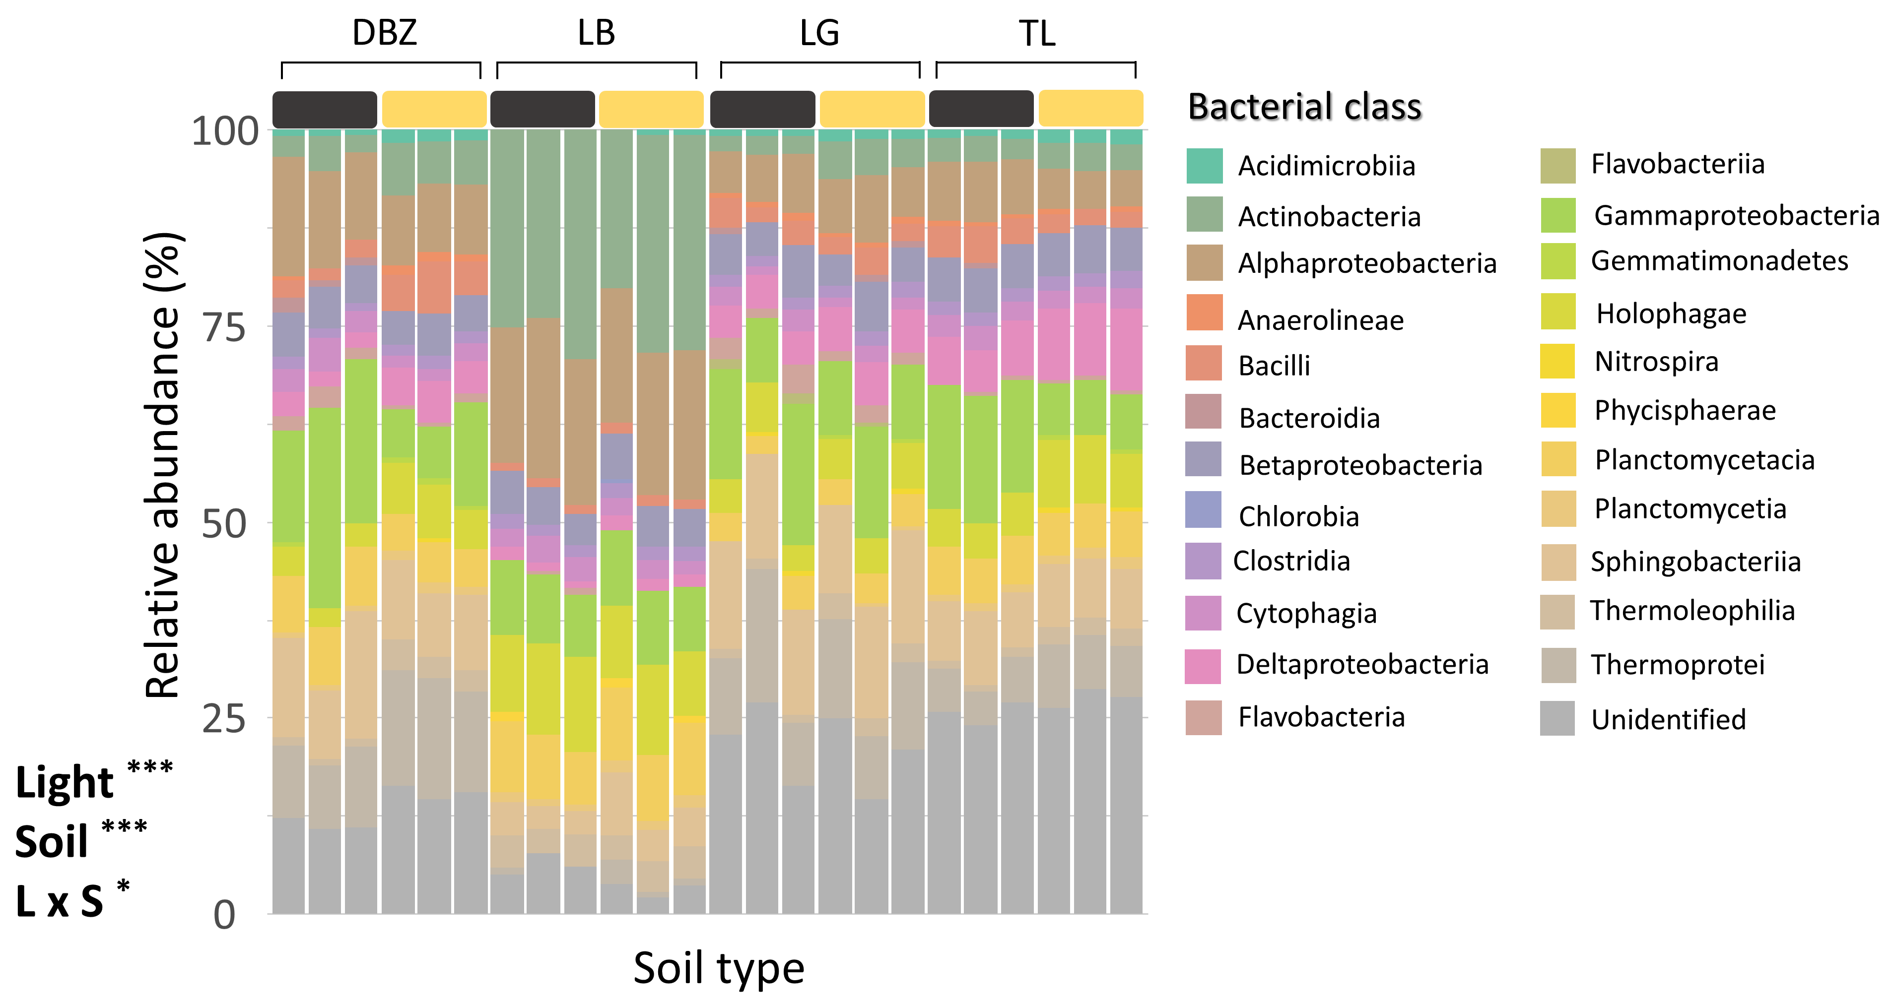
CONTEXT
EXPERIMENTAL DESIGN
RESULTS
DISCUSSION
Results
Bacterial community composition
Community composition for bacteria across the different soil types and light treatments.

Slide 53
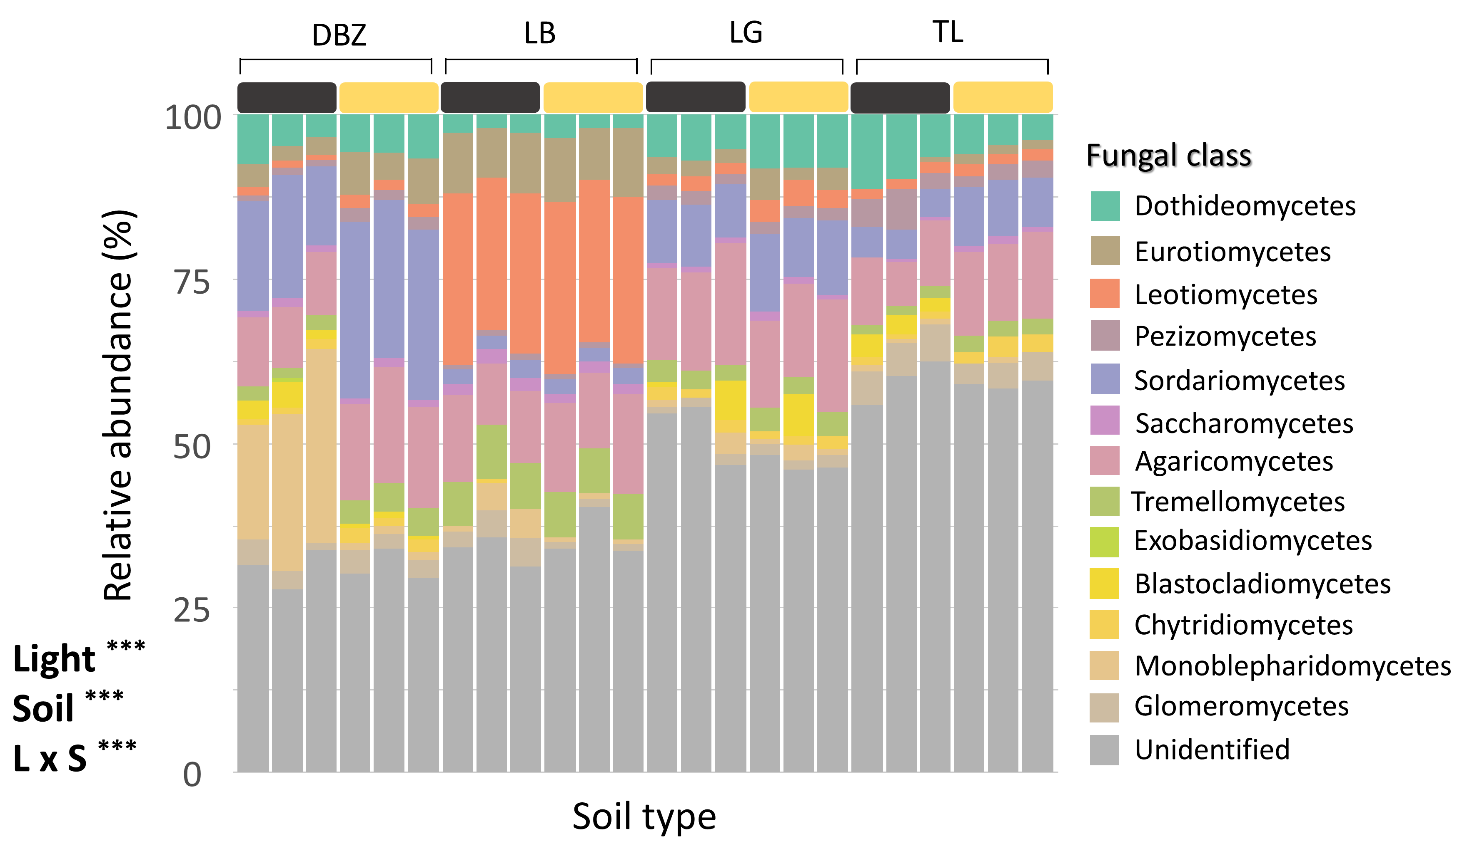
CONTEXT
EXPERIMENTAL DESIGN
RESULTS
DISCUSSION
Results
Fungal community composition
Community composition for fungi across the different soil types and light treatments.

